Slide 1

Electronic Portfolio
Salman Hasan Kanian
School Year
2011-2012

Slide 2
Personal Stationary
Business Card
Envelope
Letterhead

Slide 3
All About Me
CV/Resume
Letter of Application

Slide 4
Vocabulary Essays
1st Semester
September 9, 15, 21, 27
October 7, 14, 21, 28
November 11, 15, 25
2nd Semester
February 10, 17, 24
March 2, 9, 16, 23
January 5, 11, 18
May 10
April 13, 27

Slide 5
Formal Papers
Other Papers
Epic Hero Superhero Compare & Contrast
Shakespeare Compare & Contrast
Literary Analysis
Poetry
Short Story
Novel
College Essay

Slide 6
On Demand Essays
Asian Persuasive
Taoist
Confucianism
Asian Comparative
Taoist
Confucianism
Explanation
How to
bake, fix or make
Which is better
Website Analysis
Movie Review
How to tell a good website
Review a popular movie

Slide 7
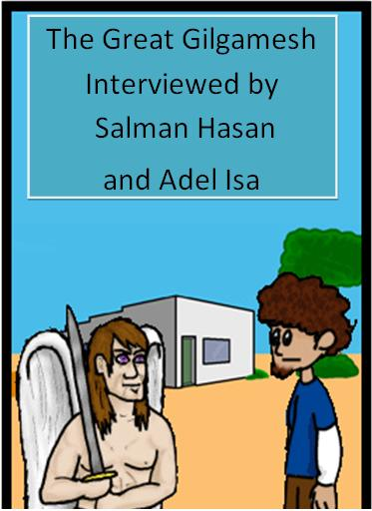
Epic Hero Comic Book
Mrs. Timm assigned this project to teach us about technology, dialogue and interview skills. We need to take the information for an interview out of the literary text book. By creating question and answers, we were able understand the epics that were read.
For this project, my partner and I received an A.

Slide 8
Japanese Poetry
Haiku
My partners and I worked together to create one coherent poem. Ours was done in sequence. We received a full mark
Tanka
My other two partners and I worked to create an advertisement about Hikkido, which illuminated the sights to see.

Slide 9
Parent Teacher Interview
Reem Kanian
Mr. Jacob

Slide 10
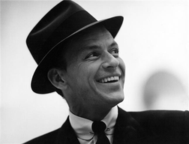
Power Point Research
Frank Sinatra Presentation

Slide 11
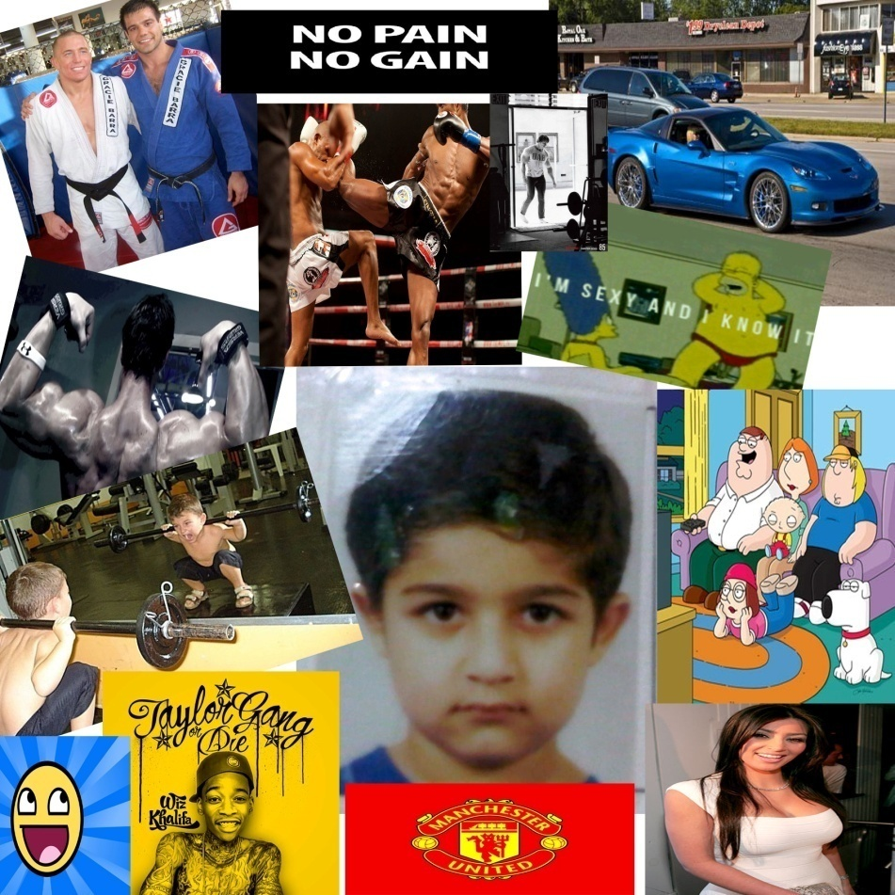

2012 & 2022 Self Portrait

Slide 12
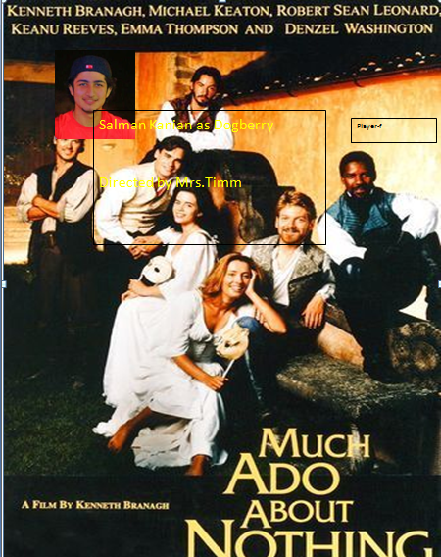
Movie & Poster
These projects were done for fun and education. The poster was for fun, but also taught us about how to use technology to create an advertising item. The movie was done to let us see how we sound look when we speak. These two projects help us with speech and technology skills.
http://www.youtube.com/watch?v=ERJMbh2XJcA

Slide 13
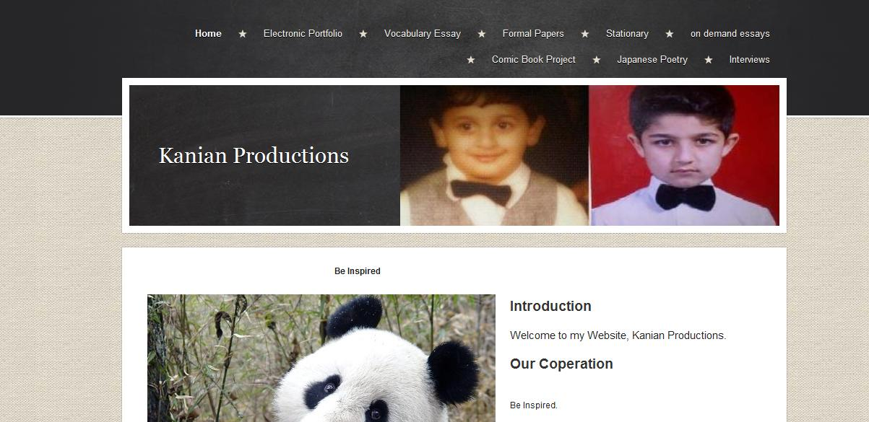
Personal Web Page
http://kanianproductions.yolasite.com/

Slide 14
Senior English Reflection
This year we have done a lot of things. In English twelve we have covered essays, projects, and many more with that.
I learned how to work as a team, write various poems, and write essays. We even made videos of ourselves which was a rather interesting experience.
In my opinion, the poem was the hardest assignment since I am not creative and would rather write a thousand word essay than an 18 line poem/sonnet. Not only did we work on essay and videos, however, we even had the experience of interviewing a teacher and a parent. I learned a lot when doing this assignment, especially in the part where I interviewed the teacher since he is not a relative, therefore, he is not close to me. I, for once believe that we have achieved so much this year because of all the varieties of assignments. Truly, it was very exhausting, but in the end I learned so much from it and I am very grateful to be in this English class, and not any other.
Mrs. Timm is probably the best teacher I have came across in my 12 years of school. I love her a lot and will use everything she taught me throughout my years of education to come. And the other things ill use in life.

